Slide 1
REAL ESTATE
Price Prediction
By – Deepak Verma
Rajeev Pandey
Pranav Gaur

Slide 2
TABLE OF CONTENTS
01
02
03
Introduction
Problem Statement
DATASET
04
05
06
Resources Used
Outcome
Our Team
Here you could describe the topic of the section
Here you could describe the topic of the section
Here you could describe the topic of the section
Here you could describe the topic of the section
Here you could describe the topic of the section
Here you could describe the topic of the section

Slide 3
Abstract
House price forecasting is an important topic of real estate. The literature attempts to derive useful knowledge from historical data of property markets. Machine learning techniques are applied to analyze historical property transactions in India to discover useful models for house buyers and sellers. House price prediction can help the developer determine the selling price of a house and can help the customer to arrange the right time to purchase a house.

Slide 4
Problem Statement
Real estate price prediction is a challenging problem in the field of machine learning and data analytics. The real estate industry is highly volatile, and the prices of properties fluctuate based on various factors such as location, size, amenities, and market demand. Accurate prediction of real estate prices is crucial for various stakeholders such as buyers, sellers, investors, and real estate agents. However, the existing methods of predicting real estate prices rely on manual data analysis, which is time-consuming and prone to errors..

Slide 5
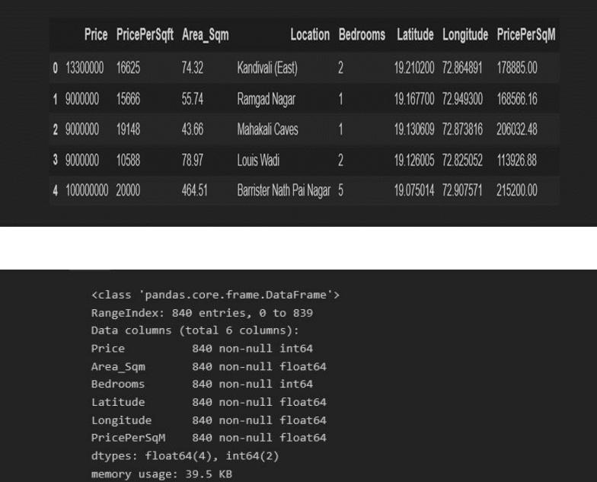
DATASET
Here we have web scrapped the Data from 99acres.com website which is one of the leading real estate websites operating in INDIA.
Our Data contains Bombay Houses only

Slide 6
Resources Used
Hardware
Software
3
A programming language, such as Python, that is suitable for data analysis and machine learning and A machine learning framework,such as TensorFlow or PyTorch, that can be used to build and train predictive models.
1
A computer with sufficient processing power and memory to handle the application and its data.
4
A dataset of real estate prices and related features, such as location, square footage, number of bedrooms, etc and Data preprocessing tools, such as Pandas and NumPy, to clean and transform the data.
2
A dedicated server or cloud infrastructure to host and scale the application.

Slide 7
Outcome
The outcome of a real estate price prediction project would be an application that can accurately predict the price of a given property based on its features and other relevant factors.Ultimately, the goal of the project would be to create a reliable and accurate real estate price prediction tool that can assist buyers, sellers, and real estate professionals in making informed decisions

Slide 8
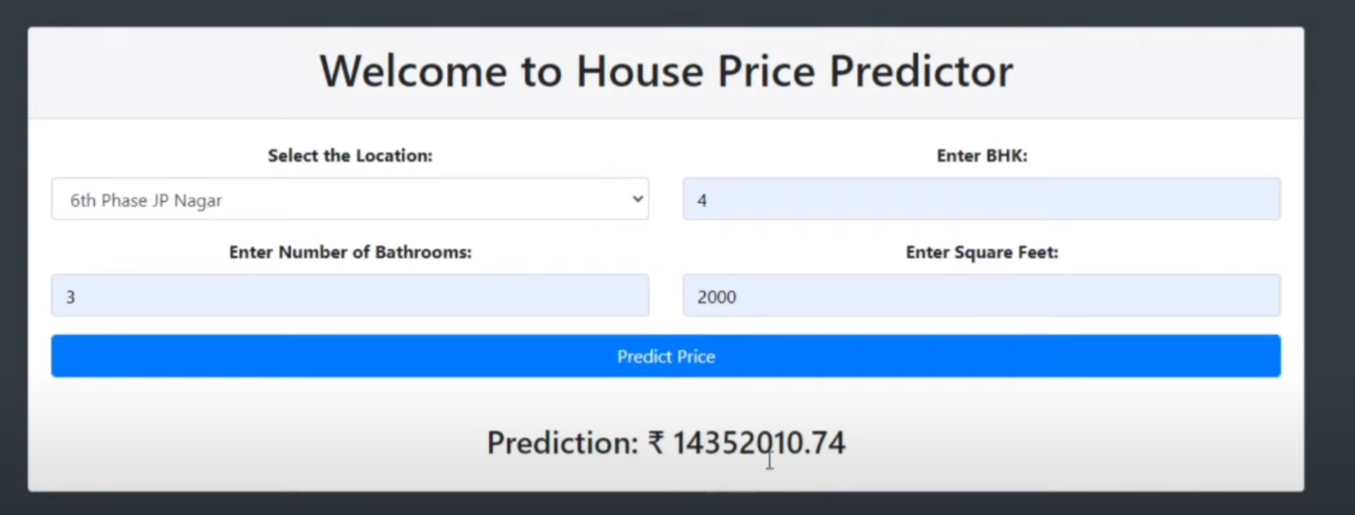
Our website

Slide 9
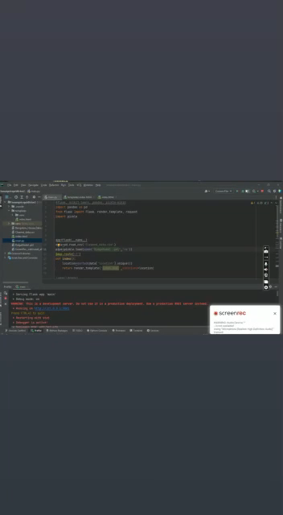
Video Demonstration

Slide 10
OUR TEAM
Rajeev Pandey You can replace the image on the screen with your own
Deepak Verma You can replace the image on the screen with your own
Pranav Gaur
MASTER

Slide 11
Conclusion
In conclusion, our machine learning model and web application are powerful tools for anyone looking to navigate the complex world of real estate in Bangalore. By leveraging the latest in data science and web development technologies, we've created a reliable and user-friendly platform that provides valuable insights into the real estate market. Try it out for yourself and experience the power of machine learning in real estate!

Slide 12
THANKS
Does anyone have any questions?

